Slide 1

Used Cars Sale Price Prediction
-Yash Bhardwaj

Slide 2
Outline
Introduction
EDA steps and Visualization
Building Models
Best Model
Conclusion

Slide 3

Introduction
The value of a car drops right from the moment it is bought and the depreciation continues with each passing year. In fact, in the first year itself, the value of a car decreases by 20 percent of its initial value.
With the covid-19 impact in the market, we have seen lot of changes in the car market. Now some cars are in demand hence making them costly and some are not in demand hence cheaper. One of our clients works with small traders, who sell used cars. So, they are looking for new machine learning models from new data. We have to make car price valuation model.
Problem Statement: We need to build a machine learning model predicting the Sale Price of the used cars based on several features.

Slide 4
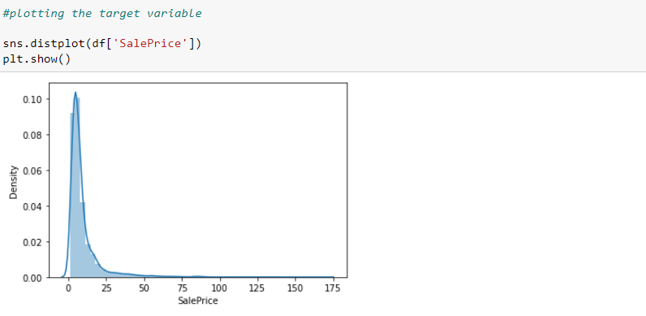
EDA steps and Visualization
So, for building machine learning models certain processes need to be done. The first one is to import the datasets and do the data analysis or exploration. The dataset had to be formed using web scraping from websites like cars24, cardekho.com etc. The dataset formed has 9 variables including response variable with 10028 examples.
After that comes EDA i.e. exploratory data analysis and data visualization.
So first we checked out the response variable:

Slide 5
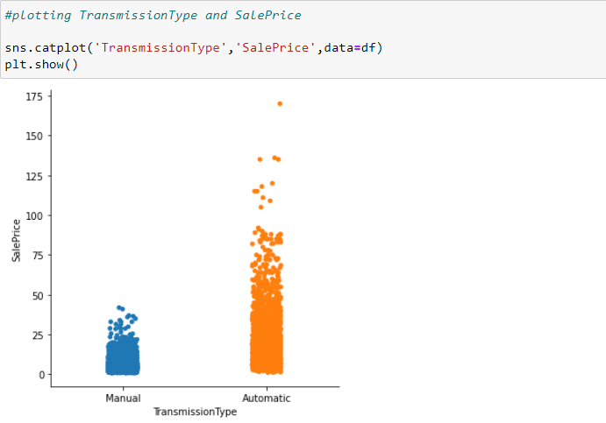
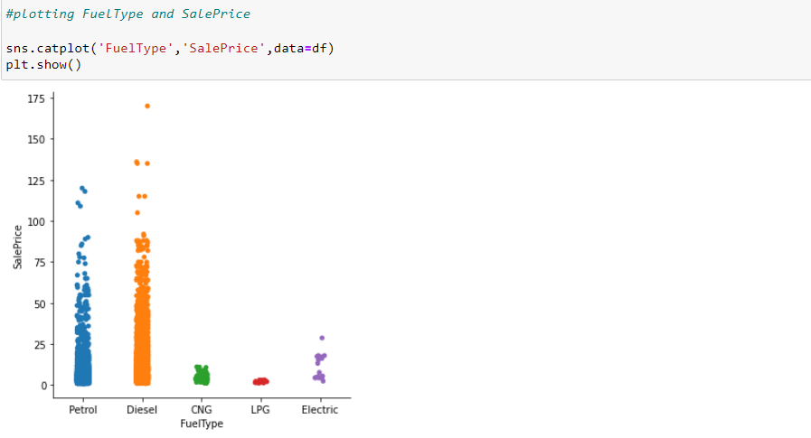
The figure gives us the distribution plot of the sale price. Most of the points are assembled between 0-25.
The distribution of sale prices are right skewed, which shows the distribution of the sale prices isn’t normal. It is reasonable because few people would buy expensive used cars.
Afterwards, we plotted other variables with the target variable.

Slide 6
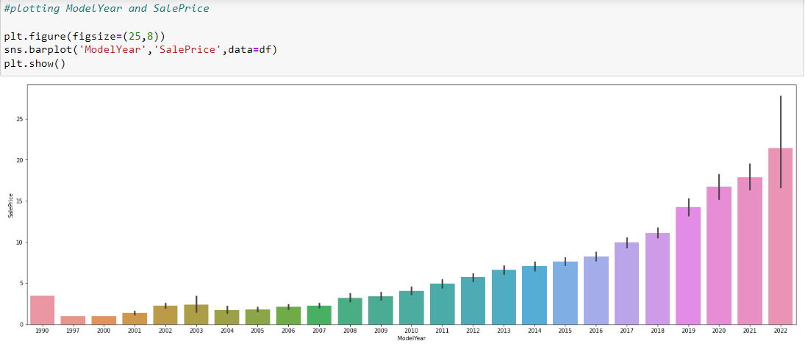
The above two figures shows relationship of sale price variable with transmission type and fuel type variables respectively.
This two figures gives us that for highest sale prices the transmission is manual and fuel type is diesel.
Manual transmission vehicles are way cheaper than automatic transmission vehicles.
Both petrol and diesel vehicles have good sale price range and for CNG and LPG vehicles sales price has very short range.
The below figure gives relationship between model year and sale price:

Slide 7
The figure shows that Year the model been made seems to be correlated with the target variable.
Model year 2022 certainly has the highest sale prices of used cars.
While model year 1997 has the lowest sale prices year 1990 has higher sale prices than 1997 to 2008 model year.
So after plotting sale price variable with location variable, data pre-processing was done.
Firstly, skewness was checked, then we applied log transformation on the data that was highly skewed.
Once skewness was reduced all the categorical variables were turn into numeric ones so that we can process further with model building algorithms.

Slide 8
Building Models
We had trained several Machine Learning models and compare their results. Later on, we had used cross validation and other evaluation metrics.
So, we had tried in total nine different algorithms which include, linear regression, 2 regularization methods, k-neighbors, decision tree, 3 ensemble techniques and xgboost.
While trying out different models we had compare the accuracy score for the best fit model.
We had also compared the errors but accuracy was main base.

Slide 9
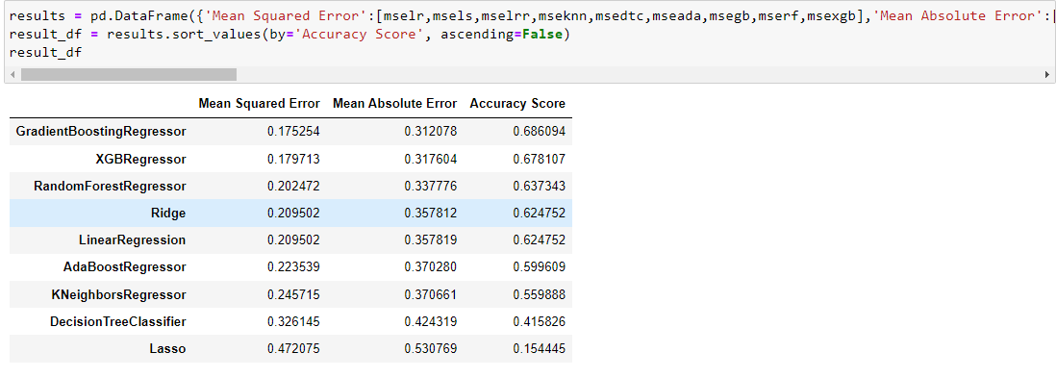
Best Model?
As we can see, the Gradient Boosting Regressor goes on the first place. But first, we must check, gradient boosting performs, when we use cross validation.

Slide 10
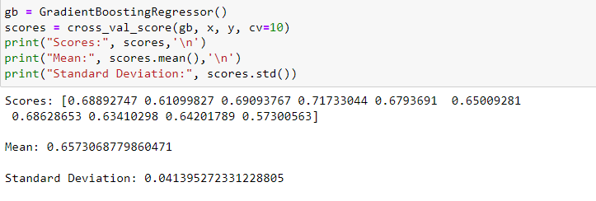
This looks as realistic as the accuracy score for gradient boosting. Our model has an average accuracy of 66% with a standard deviation of 4 %. The standard deviation shows us, how precise the estimates are. This means in our case that the accuracy of our model can differ + — 4%.
We had performed K-Fold Cross Validation on our random forest model, using 10 folds (K = 10). Therefore it outputs an array with 10 different scores. We then needed to compute the mean and the standard deviation for these scores.

Slide 11
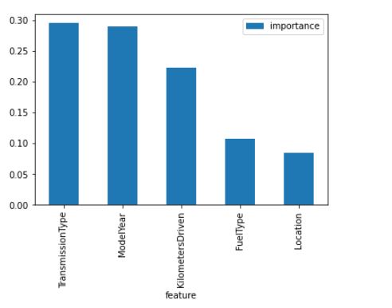
Feature importance:
Another great quality of gradient boosting is that they make it very easy to measure the relative importance of each feature.
It came out to be that 21 location variable doesn’t play a significant role in our gradient boosting regressor prediction process. Because of that we dropped it from the dataset and trained the regressor again. What this plot also tells is that type of transmission and model year are very important variables in predicting the price of a used car following by kilometres driven.

Slide 12
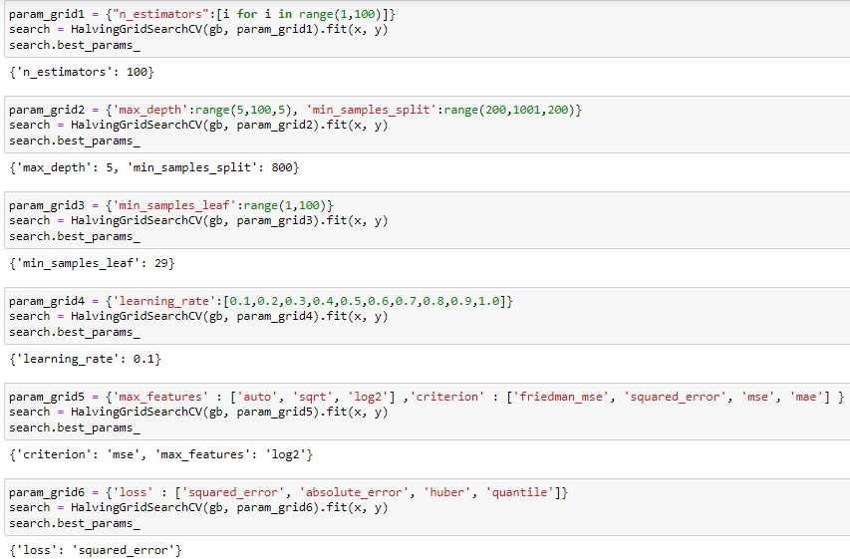
So, now that we had selected the model it was time for some hyperparameter tuning for optimized performance. The figure below shows the above only:

Slide 13
After hyperparameter tuning we passed the optimum value of the parameters through the random forest and trained the model. We then again checked out for accuracy score. This time it came around 68.5%, which was a good sign.
So now that we had a good model we had do some evaluation metrics for better understanding of the performance of the model. One of the metrics is R-squared score.
Our Random Forest model is giving us a good r-squared score. 68.5% of R-squared means up to 68.5% of feature variables movements are completely explained by movements of label variable.

Slide 14
Conclusion
We had gone from building the datasets to building several machine learning models.
Then we found out the best fit model, did some analysing including checking feature importance and accuracy score.
Afterwards, we did hyperparameter tuning for optimized performance of the model again checked accuracy score and evaluated our final model with various regression metrics including R-squared score.
Of course there is still room for improvement, like doing a more extensive feature engineering. Another way is to do a more extensive hyperparameter tuning on several machine learning models.

